Slide 1
Getting Started with HarvardPhone Jabber
Presence
Instant Message
Jabber Softphone
Mobile Jabber

Slide 2
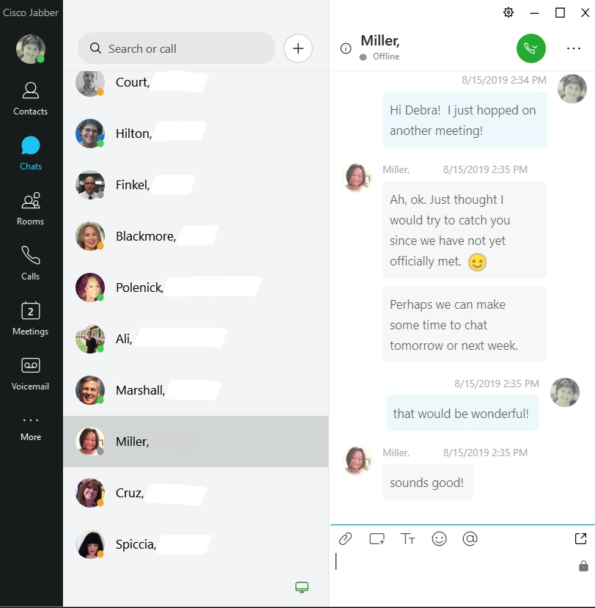
Jabber: Overview
Find the right people
See if they are available
Collaborate through Instant Messaging and the Jabber Softphone

Slide 3
Table of contents
Login and Overview
Profile and Status
Menu and Settings Gear
Contacts
Instant Messaging
Softphone
Meetings
Jabber Mobile

Slide 4
Login and Hub Screen Overview

Slide 5
Log-In
Click on the Jabber Icon:
Login with HarvardKey
Notes:
.

Slide 6
Hub Screen Overview
5
1
2
1 - Status
2 – Search Field
3 – Navigation Bar
4 – Contacts
5 – Menu Gear
6 – Phone Controls
3
4
6

Slide 7
Jabber: Profile and Status

Slide 8
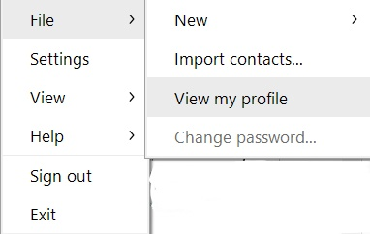
Profile
To view your profile: From the Menu Gear, select File, View My Profile
To view other profiles, right click on their icon.

Slide 9
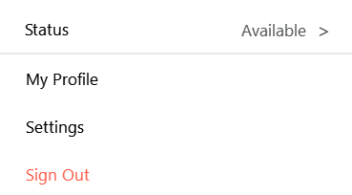
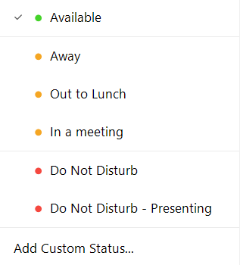
Status
Status Colors:
Green – available and okay to contact you
Yellow: Away from your desk, in a meeting, or on the phone
Red: Do not disturb; you should not be contacted
You can customize your own message: From the drop down arrow, select Add Custom Status.
Note: Maximum of 3 customized status per color.

Slide 10
Jabber: Menu and Settings Gear

Slide 11
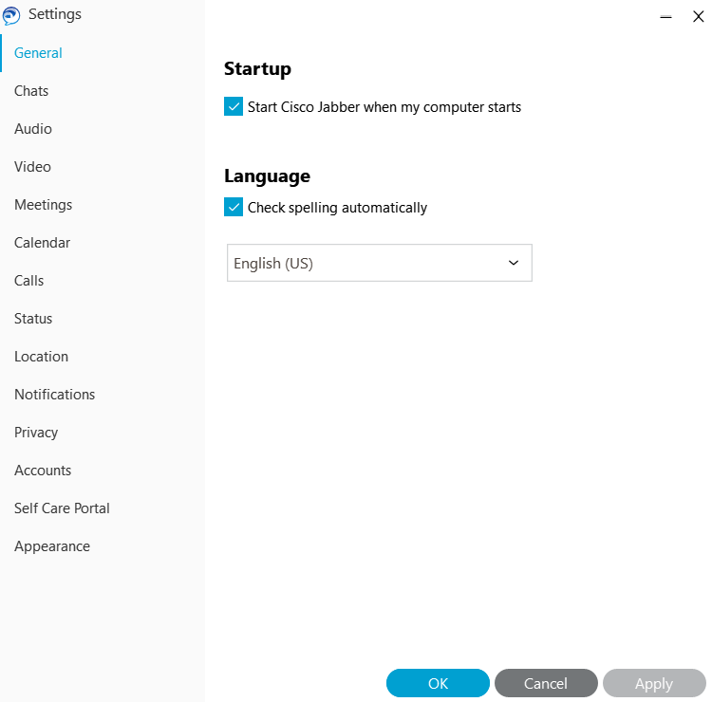
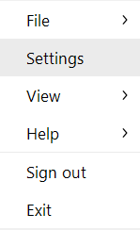
Menu and Settings Gear
To Customize Settings:
From the Menu Gear, select Settings.
This pulls up a Settings Window where many settings can be customized.

Slide 12
Options - General
1
1 - If you want Jabber to pull up when your computer starts, place a check next to “Start Cisco Jabber when My Computer Starts
2 - You can also enable Spell checker in this Settings Window
2

Slide 13
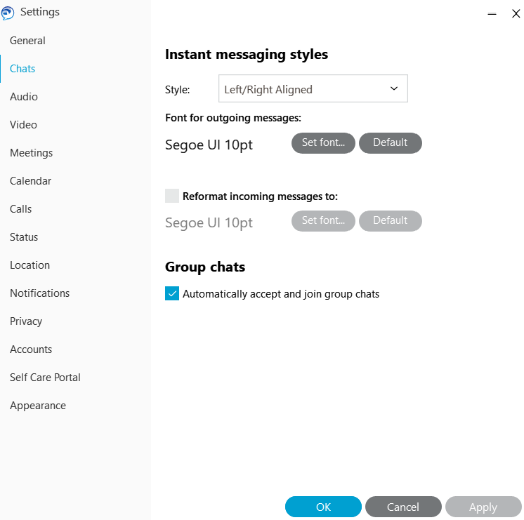
Options - Chats
From the Chats Option you can customize the font and alignment according to your preference

Slide 14
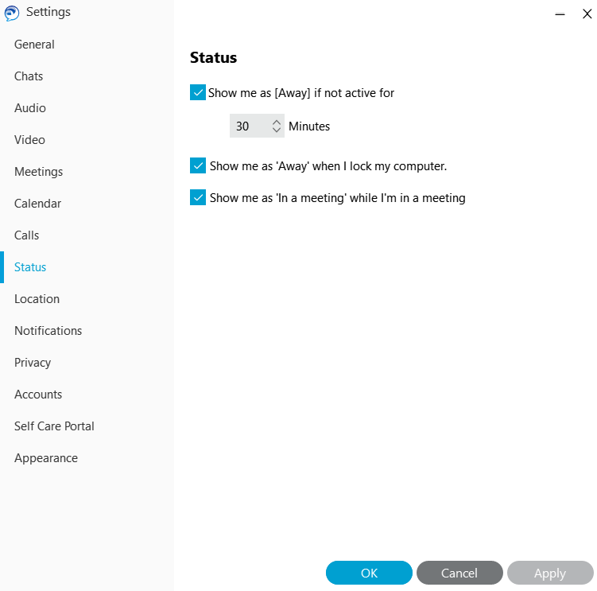
Options - Status
From Status you can customize how Jabber will display your status after you have been inactive or away.

Slide 15
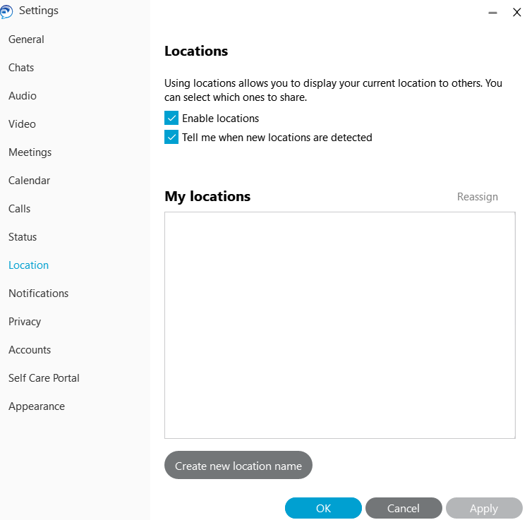
Options - Locations
When you travel, Jabber recognize you are in a new location and will ask if you want to display it on your status.
If you don’t want Jabber to recognize you have changed locations, simply uncheck “Enable Locations”

Slide 16
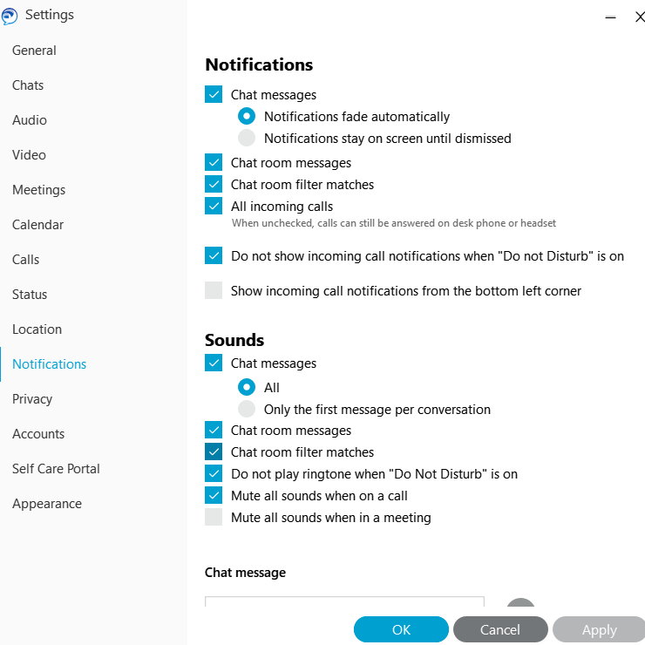
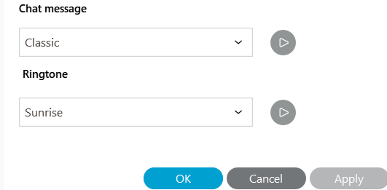
Options - Notifications
Customize Alerts and Sounds as you receive Chat messages

Slide 17
Jabber: Contacts

Slide 18
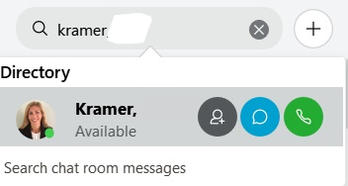
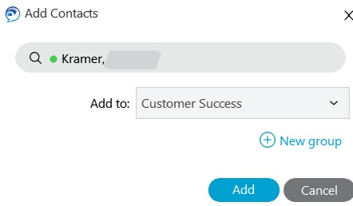
Contacts: Add a New Contact
1
To add a new contact:
1 - Start typing their name in the search bar.
2 - Roll your mouse over their name and click the Silhouette with the + sign.
4 – Click “Add”
2
3

Slide 19
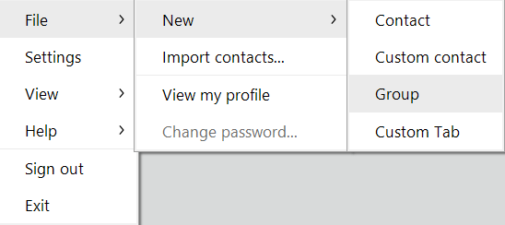
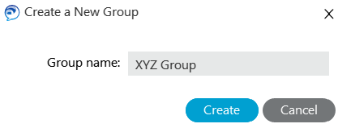
Contacts: Groups
Groups are like folders to help organize your contacts.
1- To add a new Group, from the Menu Gear, select File, New, Group
2 - Enter the Name of the Group.
3 - Click on Create
1
2
3

Slide 20
Contacts: Add Contact to Group
1
To add a contact to the Group:
1 - Start typing their name in the search bar.
2 - Roll your mouse over their name and click the Silhouette with the + sign.
3 – Select the appropriate Group name
4 – Click “Add”
2
3
4

Slide 21
Instant Messaging

Slide 22
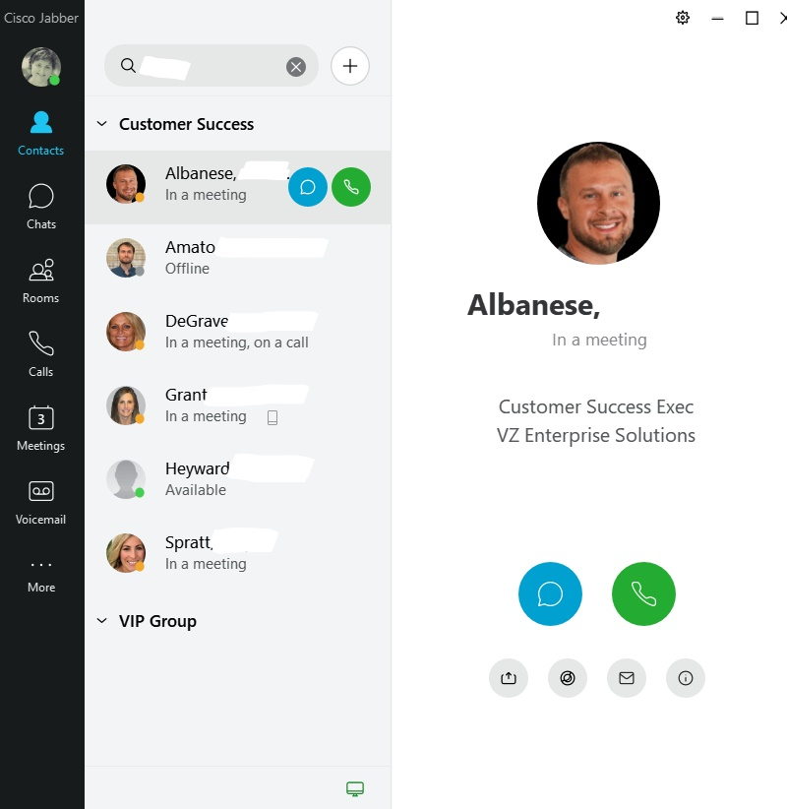
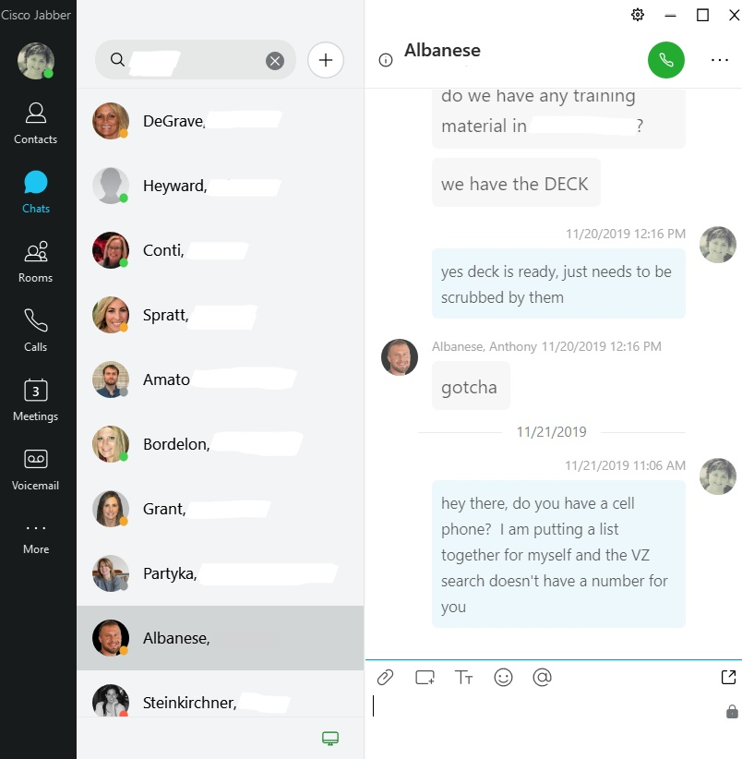
Instant Message: Sending
To send an instant message:
1 - Locate the person in your Contact List or search for them in the search bar
2 – Click the chat icon
3 – Type and send your message
2
1
3

Slide 23
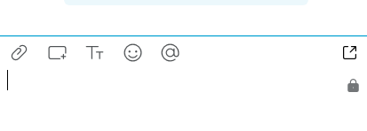
Instant Message: Options
When the chat is taking place you have various icons available. You can send emoticons, change the font, and much more.

Slide 24
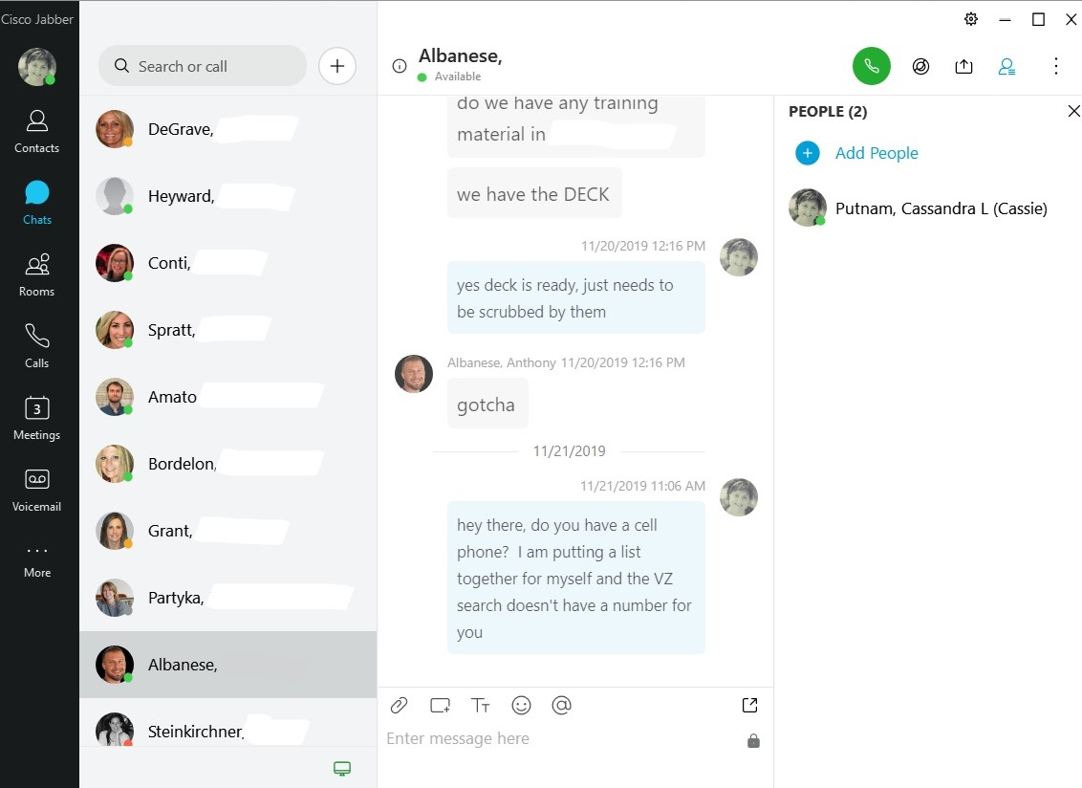
Instant Messages: Group Chats
To start a Group Chat:
1- Click on the Chat Icon
2 – Click on the Silhouettte
3 – Click on ‘Add People’
2
3
1

Slide 25
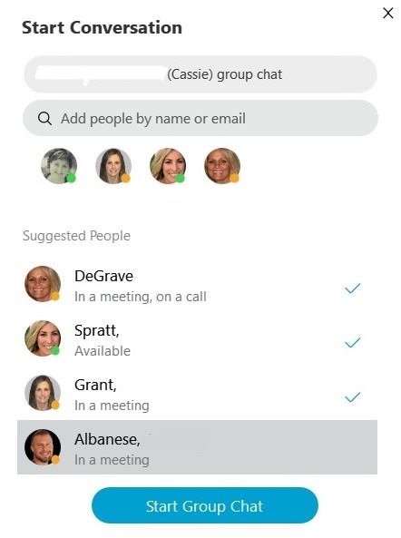
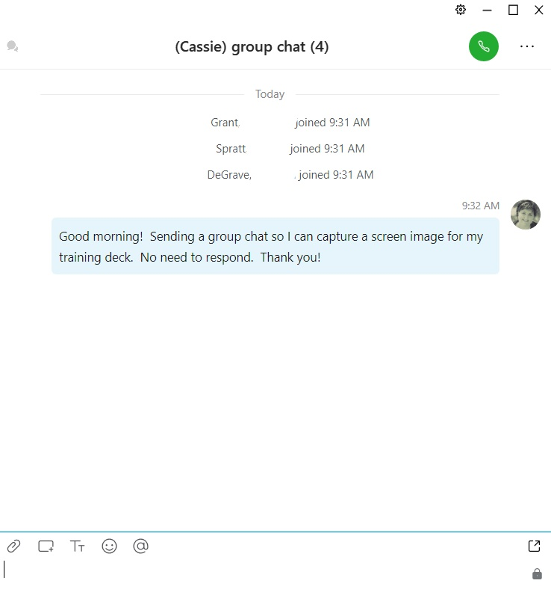
Instant Messages: Group Chats (cont’d)
4 – Place a check next to their names or search for them in the search bar
5 – Click on ‘Start Group Chat’
6 - Enter your message to begin the group chat.
4
5
6

Slide 26
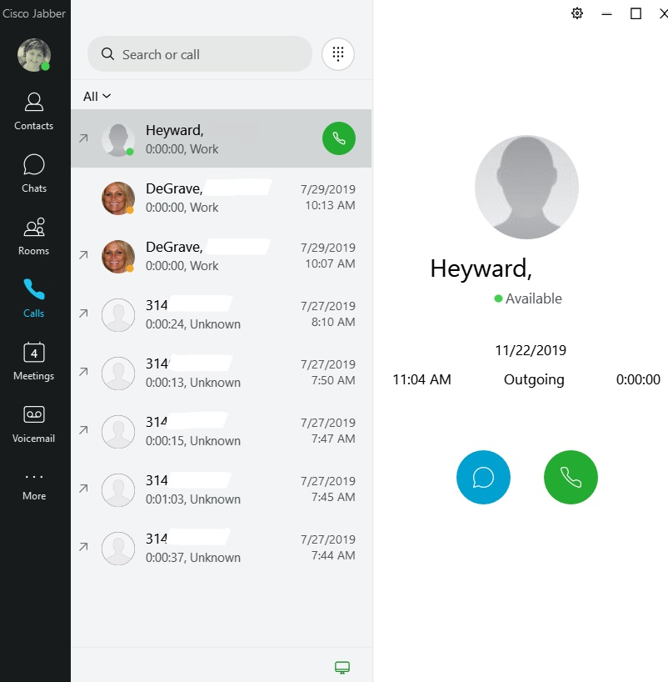
Jabber Softphone

Slide 27
Softphone – Calls Tab | Call History
To view your call history, from
the ‘Calls’ tab:
1 – Click on the call
2 – View history details such as time of call, outgoing or ingoing, and length of call
3 – Click on the Chat to send a message or the phone icon to place a call
1
2
3

Slide 28
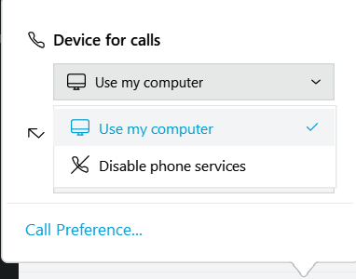
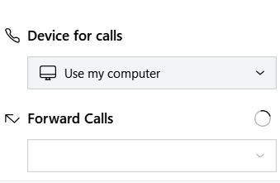
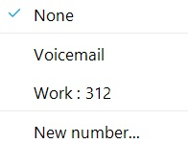
Phone Control
From the Phone Control Icon, you can choose from various phone control options: Use My Computer for calls, Use My Phone for calls, and more.
You can also forward calls to another number. If you enter a new number, those numbers will appear again to use the next time.

Slide 29
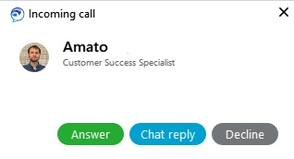
Answer A Call
Incoming calls display a notification on your screen. You can choose to answer, reply with a chat, or decline which sends the call to your voicemail.

Slide 30
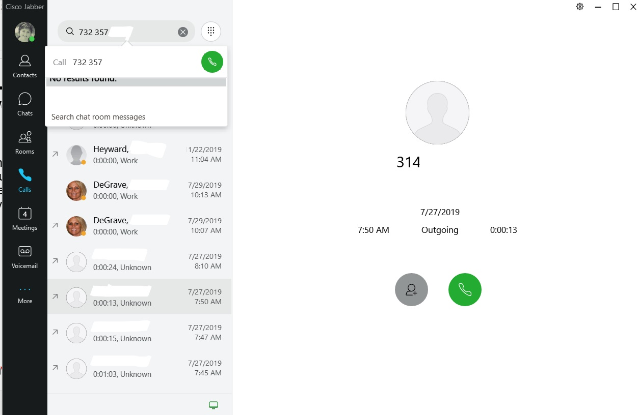
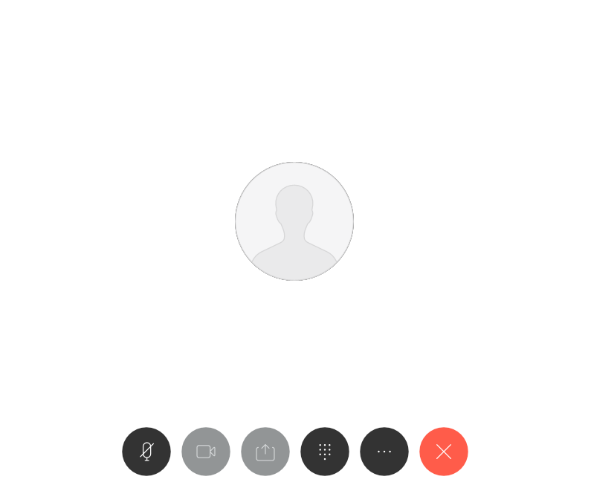
Place A Call
1
1- In the Search or Call field, enter the phone number. You can also search for people within your organization by typing their name.
2 – Click on the green phone icon to place the call
2

Slide 31
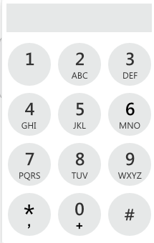
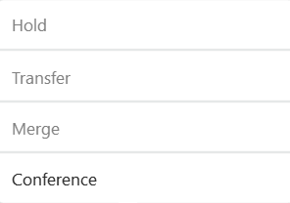
Call Controls and Features
While you are in the middle of an active call, you have several controls and features. You can mute yourself, adjust the volume, and more.
The keypad can be used to enter numbers in various menus (Press 1 to reach an operator, etc)
From the more button you can place a call on hold, transfer calls or do a conference call.

Slide 32
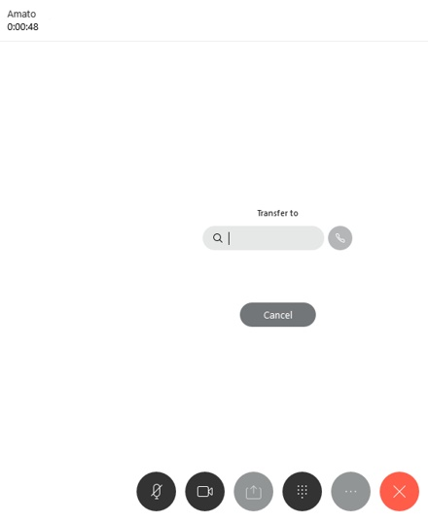
Transfer a Call
From the More button:
1 - In the ‘Transfer to’ field, enter the phone number or name of the recipient. When the phone icon turns green, click to transfer
1

Slide 33
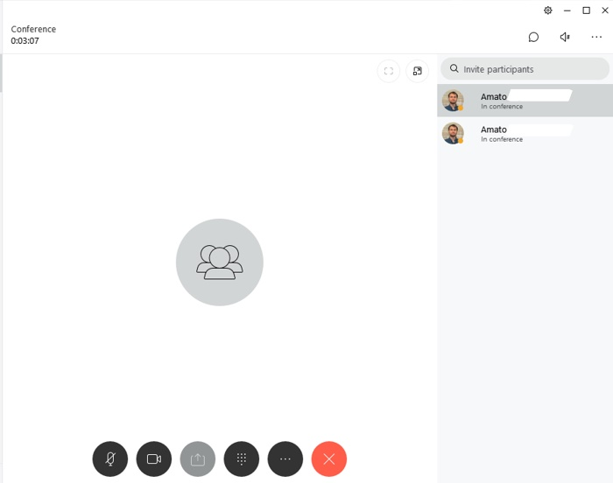
Conference Call
1
From the more button:
1 - Type the number or name of the person in the ‘Invite Participants’ field.
2 – Click the green conference icon to join the participant to the call
2

Slide 34
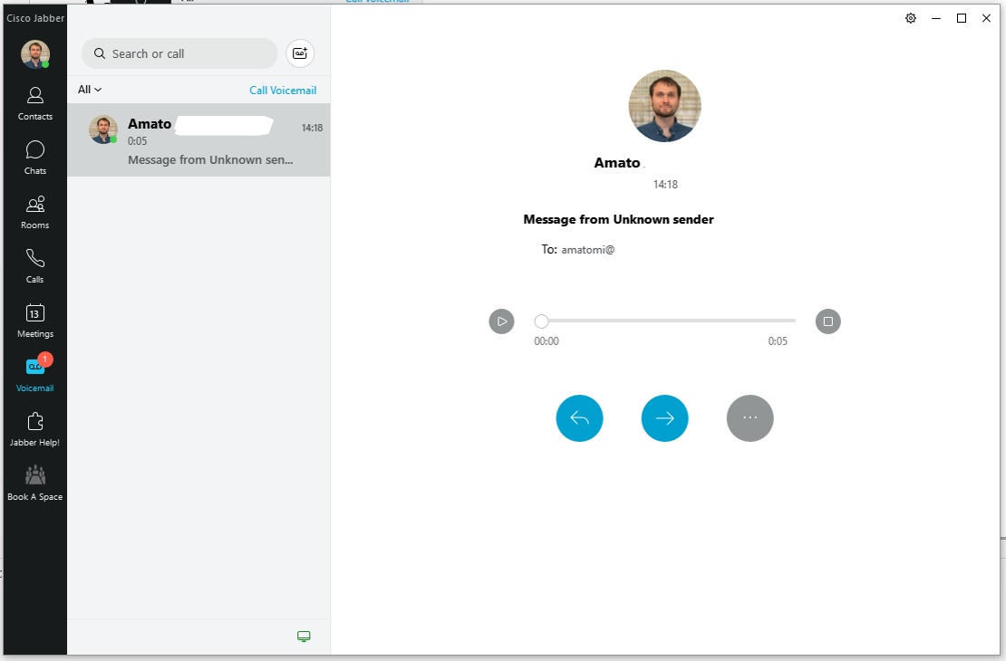
Softphone – Voice Messages Tab
Voice messages include time and date stamps, and also displays with a red number showing how many unheard messages you have.
Click on the unheard message and then click the play button.

Slide 35
Meetings Tab

Slide 36
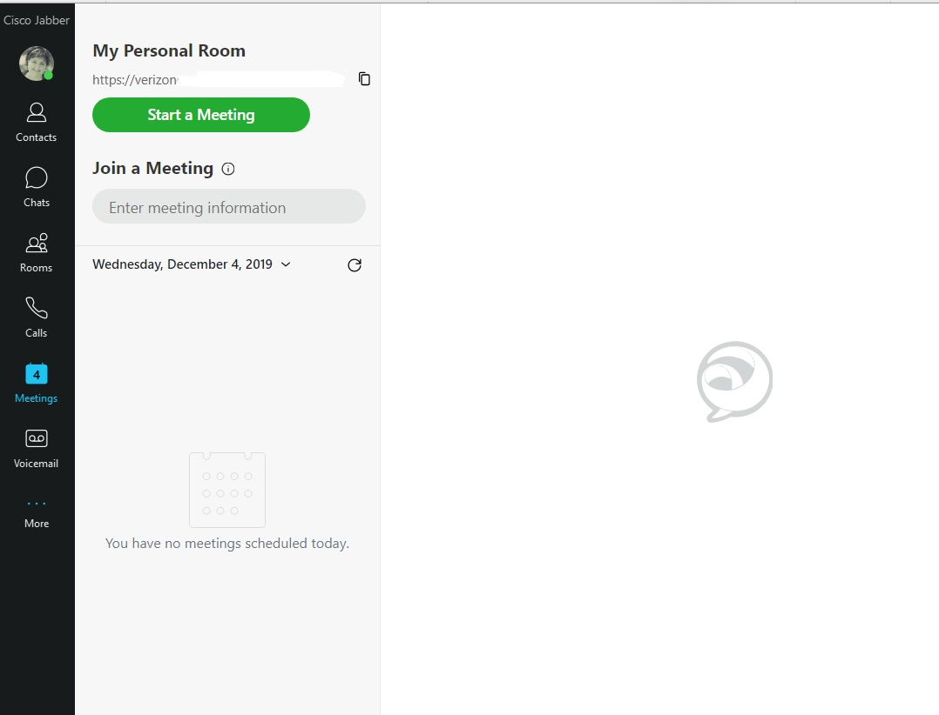
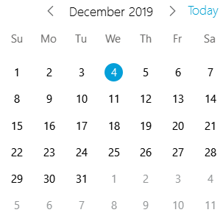
Meetings Tab
From the Meetings Tab, you can start a meeting in your Webex Personal Room.
You can join other webex meetings, as well as see a list of all upcoming meetings

Slide 37
Jabber: Mobile Device

Slide 38
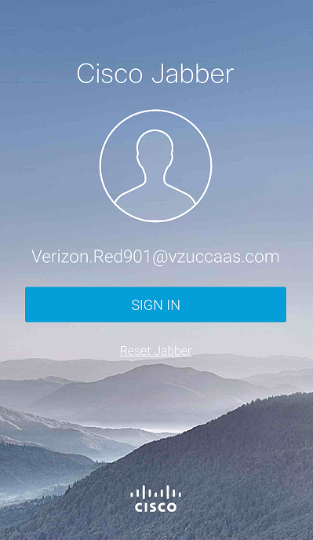
Access Mobile Jabber
Download the Mobile App from your cellphone App Store:
Login with HarvardKey

Slide 39
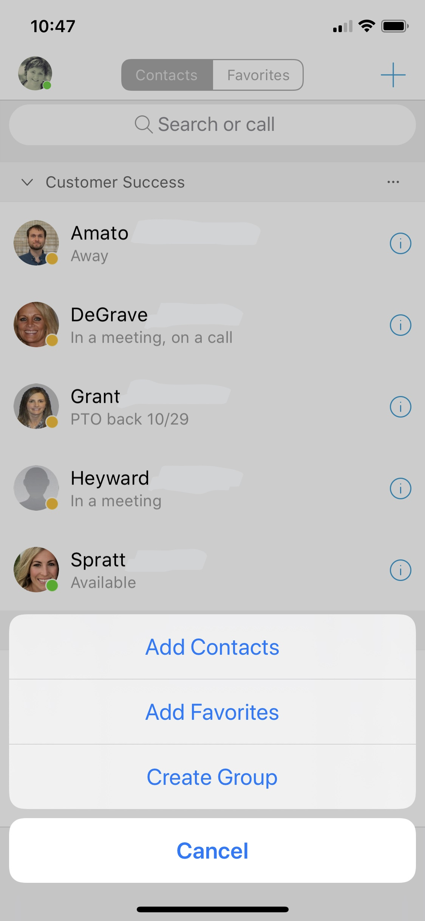
Contacts
Tap photo to access Main Screen
Add a new contact, favorites, or create a group
Search for – or call a contact
Tap Contacts to call or chat

Slide 40
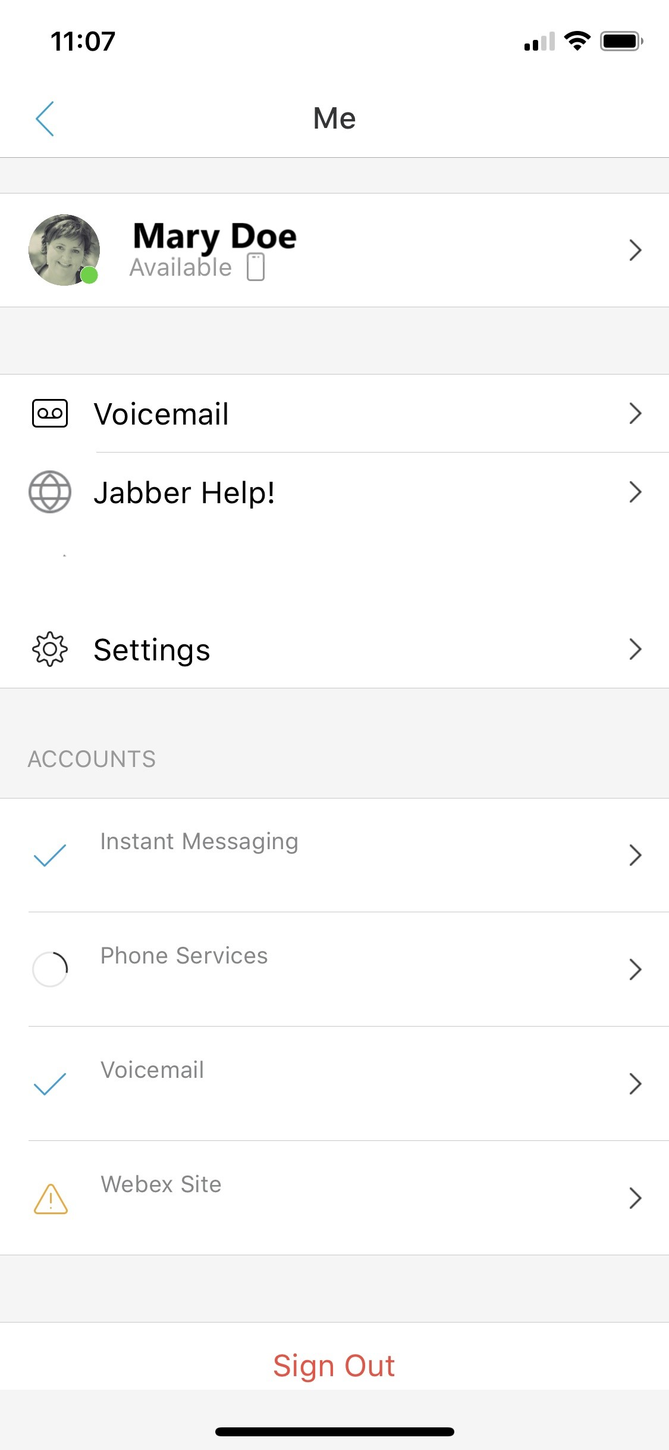
Main Screen
View or change your status
Access your voicemail
Change Your Settings

Slide 41
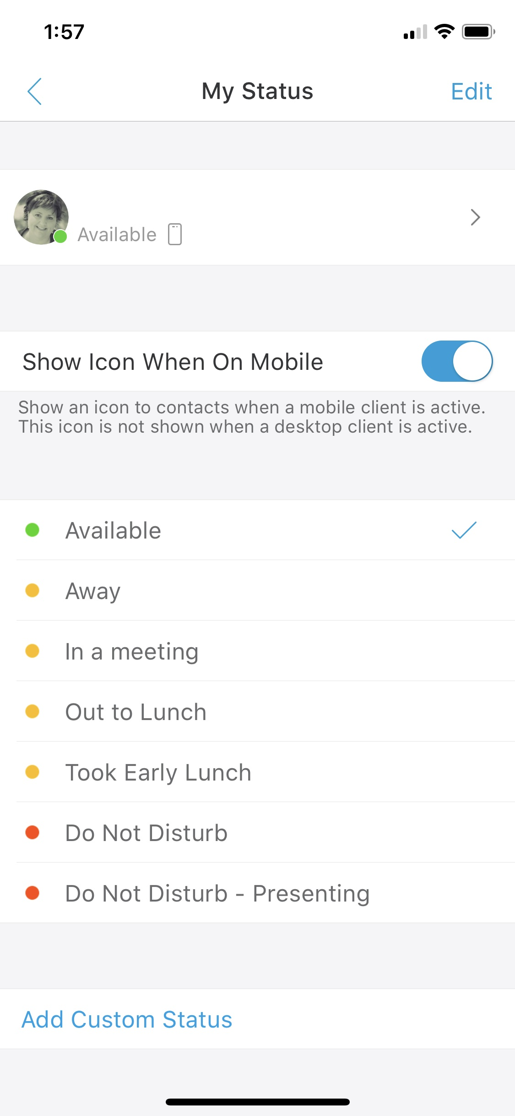
Status
Tap to change your status

Slide 42
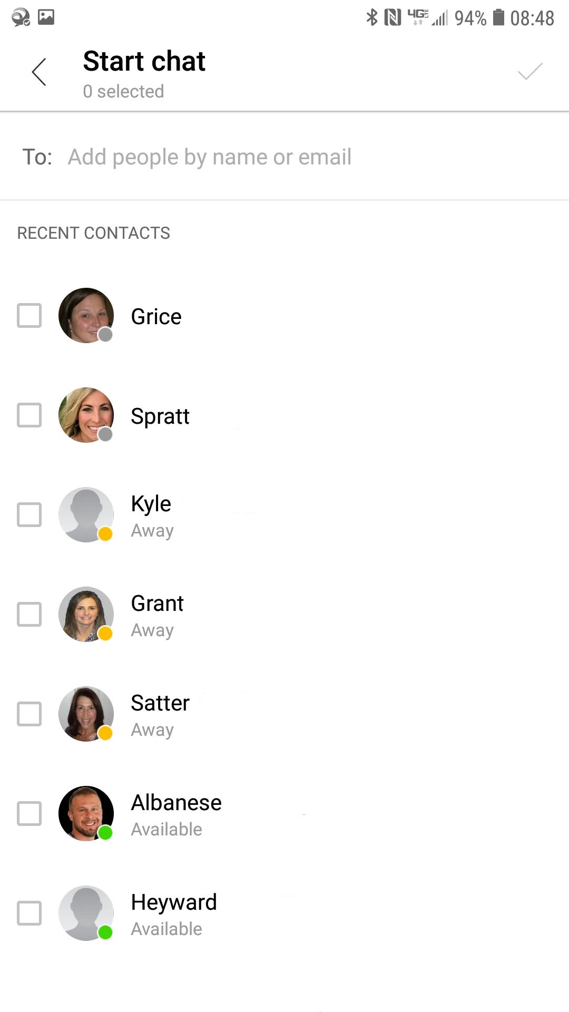
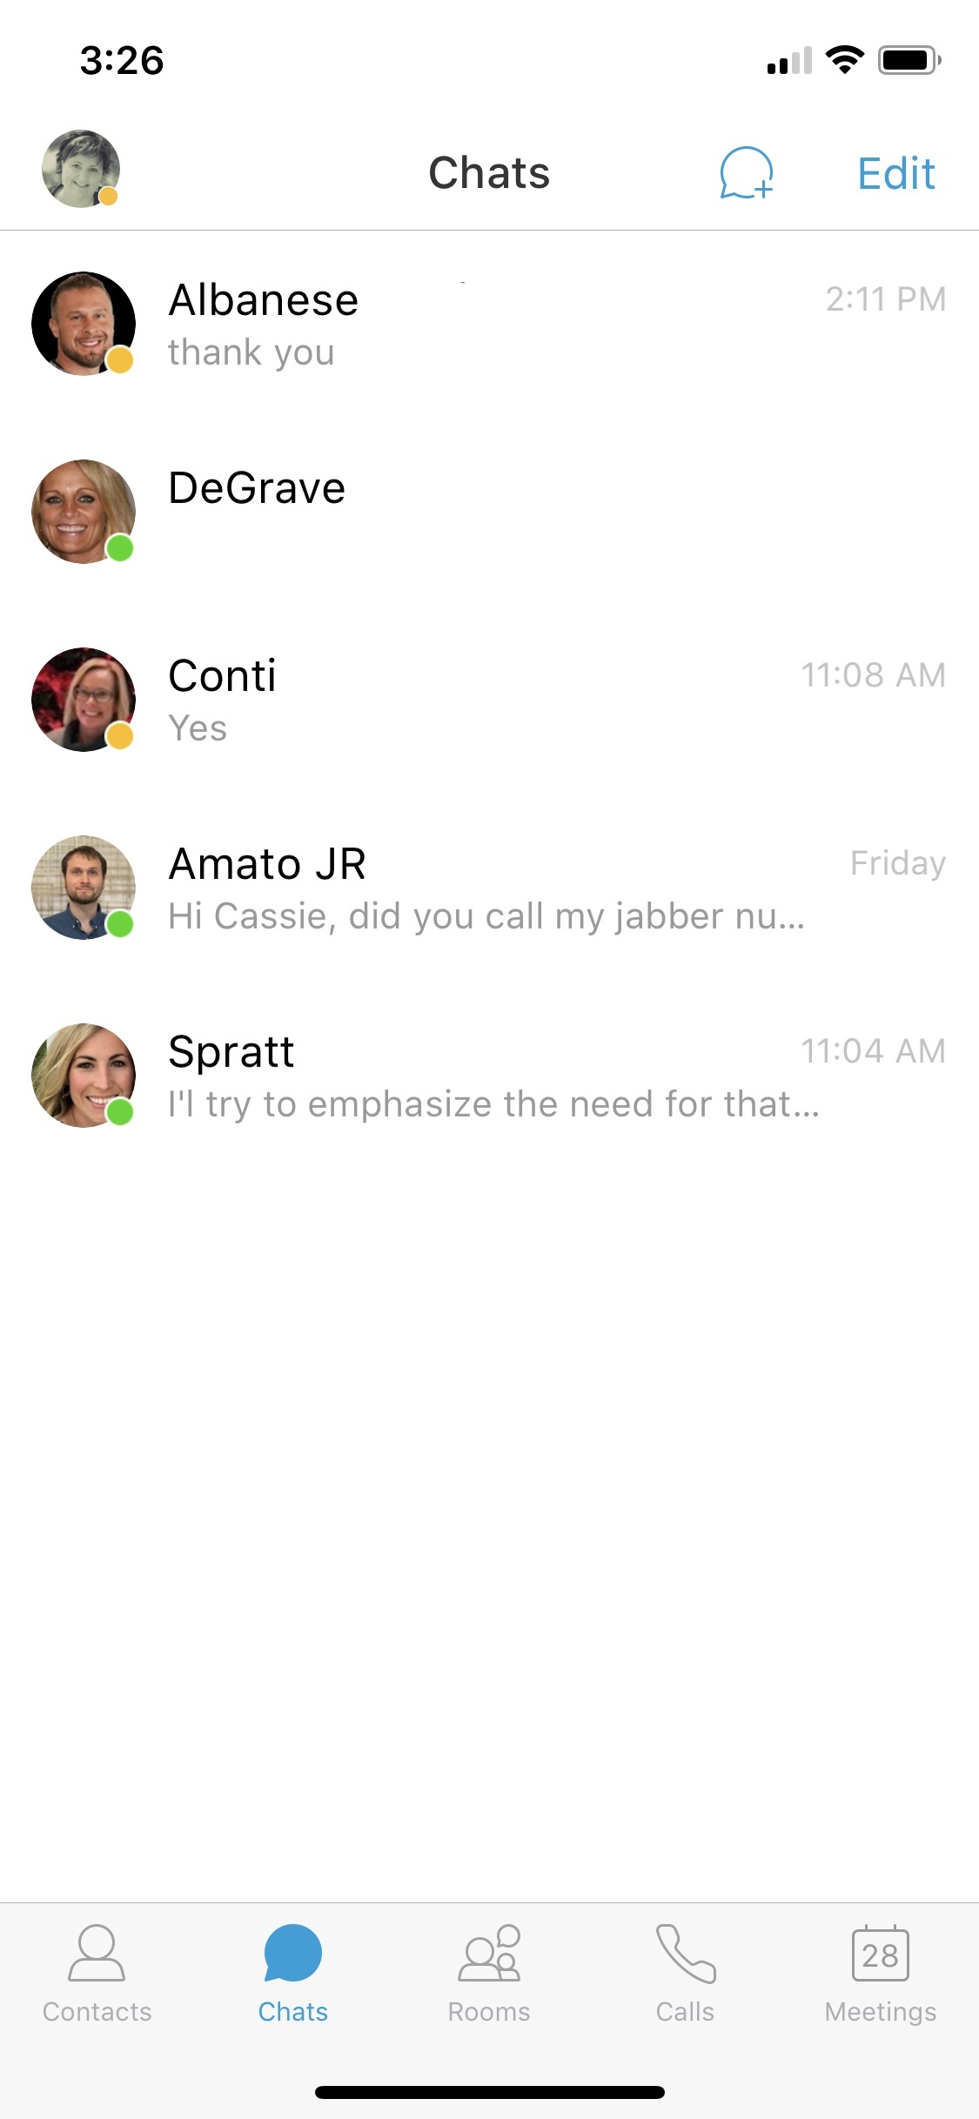
Chats | Group Chats
Click on a contact to send a Chat message or search for a contact and then send a chat.
Click here to add more participants and start a group chat
Enter Message Here

Slide 43
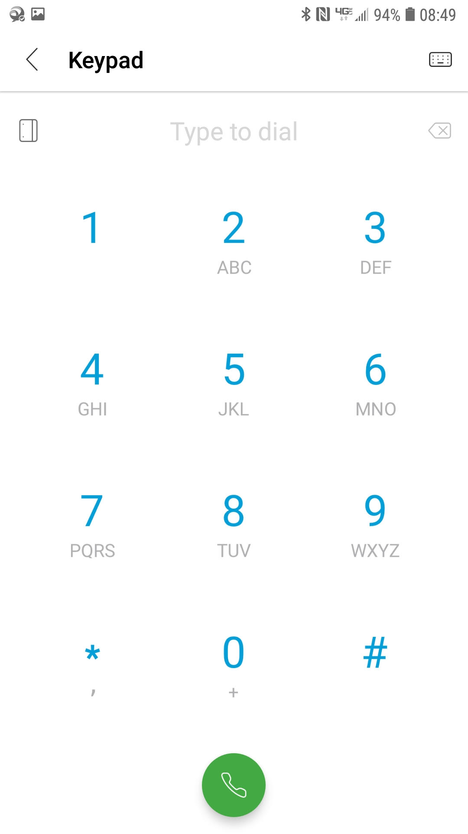
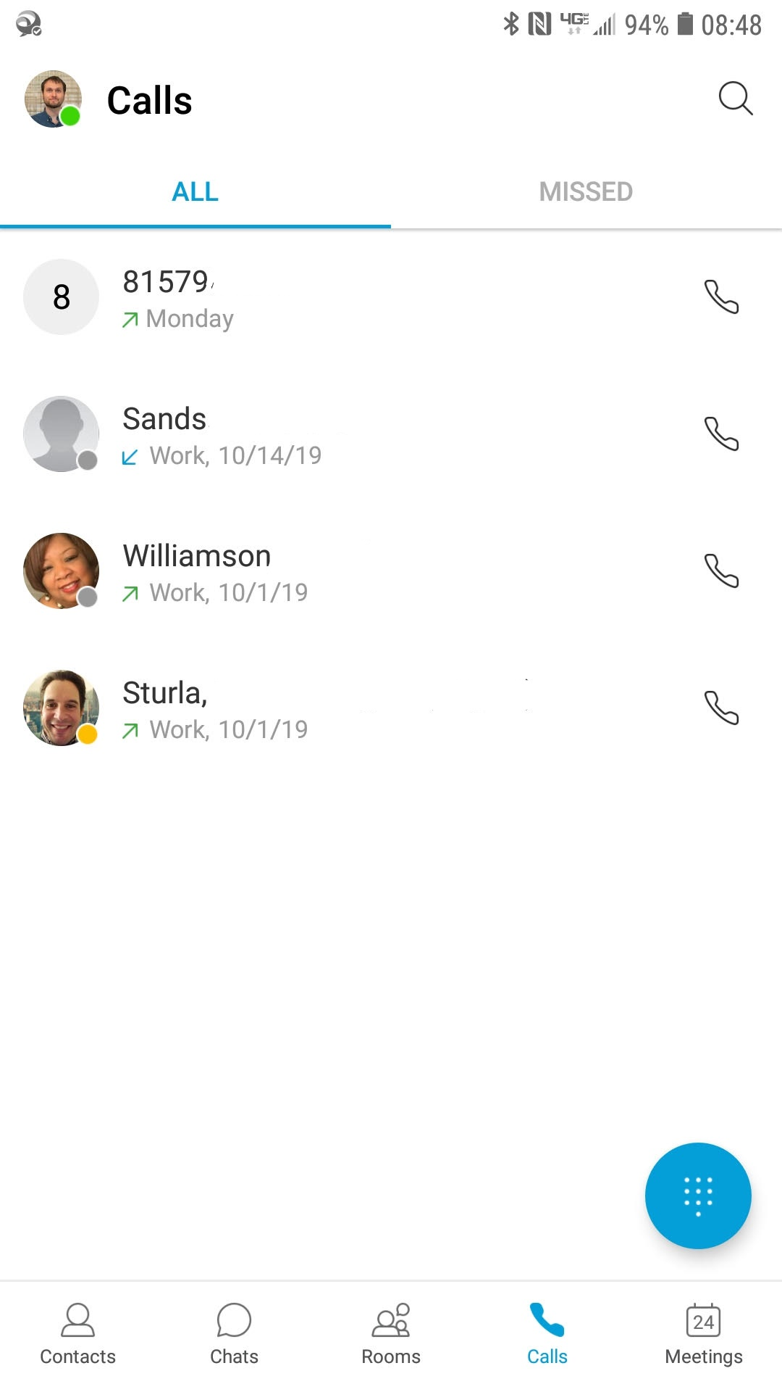
Calling | Call History
Search call history by entering a name or telephone number.
Contacts
Click on a contact to place a call or find the contact in your call history and then place the call
View calls that you missed
Tap ellipsis to
access dial pad

Slide 44
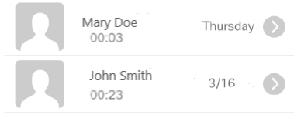
Voicemail
From the Main Screen, click on Voicemail to view and listen to voicemail messages
Play, rewind, forward,
and more

Slide 45
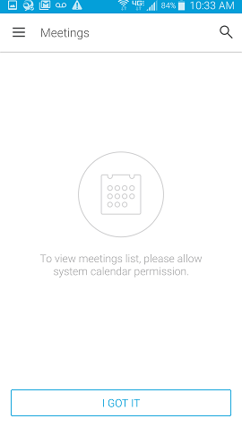
Meetings
If Cisco Webex is integrated with your Jabber, you can set up to review meetings here.

Slide 46
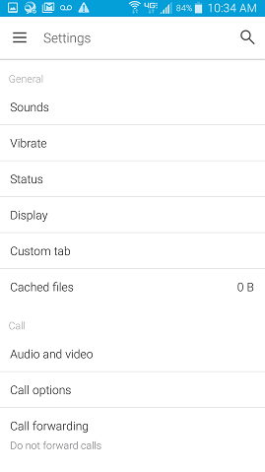
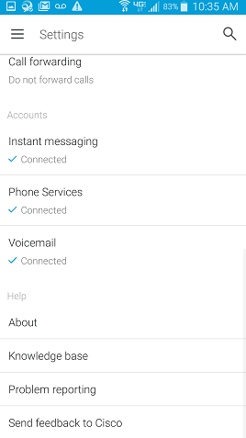
Settings
Tap on Settings to review and change setting features.

Slide 47
Resources
Add Phone Numbers, Websites, and links to Quick Reference Guides.
Add Link to this Presentation.
Send link through Chat Panel for convenience

